Slide 1
Welcome to Ms. Dodson’s Kindergarten
Class

Slide 2
Standards Based Grading
4-can apply concepts above level and consistently works above grade level
3- meeting benchmarks without assistance
2-can only meet benchmarks with assistance
1-is not meeting benchmarks even with assistance
We will have two scheduled parent/teacher conferences throughout
the school year (End of Quarter 1 and 3). I am always available if you would like to request an additional conference.

Slide 3
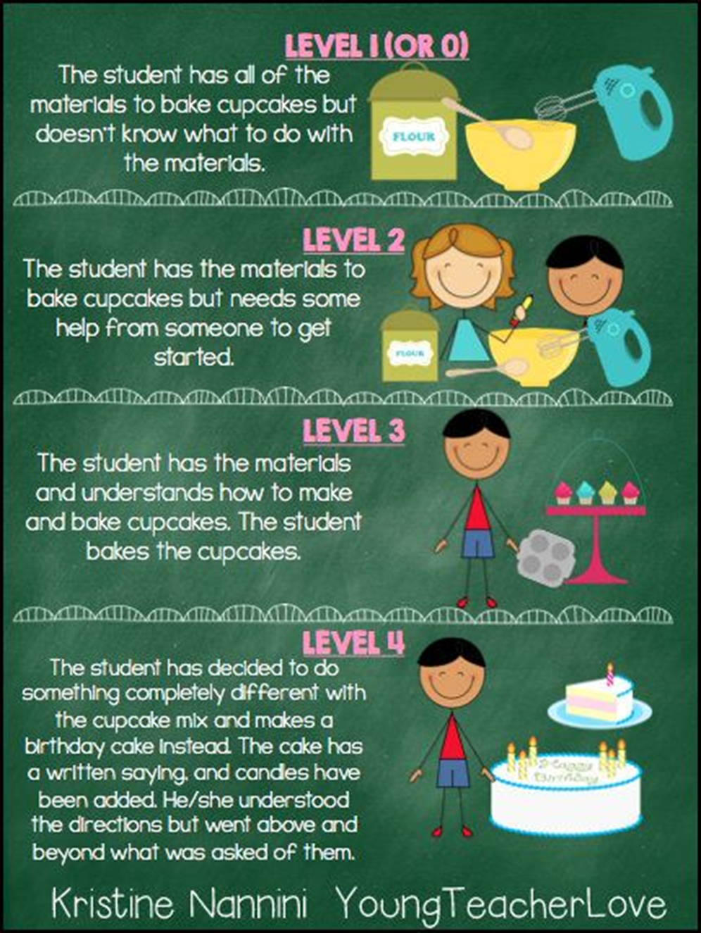
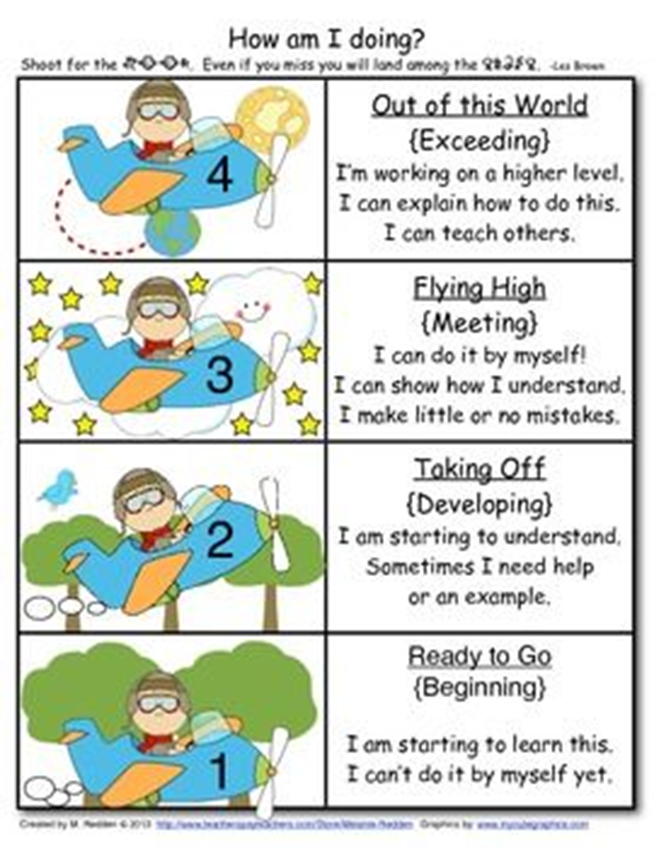

Slide 4
Behavior Management
1. Five “life skills” are taught in the context of keeping our bodies and hearts safe . . . being respectful, helpful, careful, responsible and patient.
2. Each day we look for children to demonstrate these five skills, but if a child cannot make good choices, their clip will be moved down to yellow which means that they need to think about the choices that they are making. The student has the opportunity to change their choices and move back to green “Ready to Learn”.
3. If a child’s clip keeps going down to yellow (or ends the day there), we mark it on their behavior chart to let the family know how the day ended.

Slide 5
Homework
Monthly Homework calendars are optional, but strongly encouraged. They will be posted on Blackboard. Homework is due at the end of the month.
In addition to homework, we ask that you read with your child at least 20 minutes ever night.
Homework calendars may be sent home as well. As we getting into deeper math concepts, I will be sending home paper copies of the math homework.

Slide 6
Field Trips
We usually have about four field trips a year, both on and off campus. The tentative field trips that we are planning on going on this year include: A Pumpkin Patch, a musical performance, Science Fun for Everyone (in house field trip) , and the Museum of Life and Science. The dates are still to be determined but we love to has many parent chaperones as possible to join in on the fun! ☺

Slide 7
Birthday Celebrations
Due to the large number of children in our school with allergies as well as initiatives for healthier students, it is a school wide policy that we do not have food for birthday celebrations. Instead, we invite you to come read a special book chosen by your child to our class and (if you so wish) you can then donate to our classroom library in your child’s name.

Slide 8
A Few Other Items
Absences – For an absence to be excused, a note must be sent in with the student when they return to school.
Wish List – wish list is posted on balckboard, if you would like to donate please take a post it today
Volunteers – starting in the 2nd quarter, there will be a sign up genius for volunteers in the room. Please make sure you register as a volunteer!

Slide 9
Please check green folders daily.
Please check our class webpage once a week for updates.
Weekly newsletters will now be posted on Mondays to the class webpage unless requested otherwise.
Please send in Raz-Kids fees ASAP

Slide 10
Daily Schedule
Monday - Thursday
8:45 – 9:15 : Arrival & Morning Work
9:15 – 9:30 : Morning Meeting
9:30 – 10:15 : Writing
10:15 – 11:30 : Literacy
11:30 – 12:00 : Lunch
12:00 – 12:15 : Bathroom Break
12:15 – 1:00 : Math
1:00 – 1:45 : Specials
1:45 – 2:00 : Handwriting
2:00 – 2:30 : Recess
2:30 – 2:40 : Snack
2:40 – 3:15 : Science/Social Studies
3:15 – 3:35 : Word Work/Phonics
3:35 – 3:45 : Pack & Dismissal

Slide 11
Arrival & Morning Work
Students come in, turn in their GATOR folders for review, and immediately start morning work. Each day they will work on at skills review sheet a their own pace.

Slide 12
Morning Meeting
During morning meeting, students review the days of the week, months of the year, count the days in the month, create or add to a pattern, and forecast the weather. This is where we start our day by discussing what is to be expected in the hours to come. This is also the time where the children get the opportunity to share their own special thoughts or news with the class.

Slide 13
Writing Workshop
During Writing Workshop, we start with a mini-lesson focusing on a specific skill, followed by independent writing time where the children can use inventive spelling and also refer to the print our rooms. While students are working independently, the teacher pulls students to conference each individually or in small groups focusing on a specific skill. Following independent writing, students are given the opportunity to share their work with the class.

Slide 14
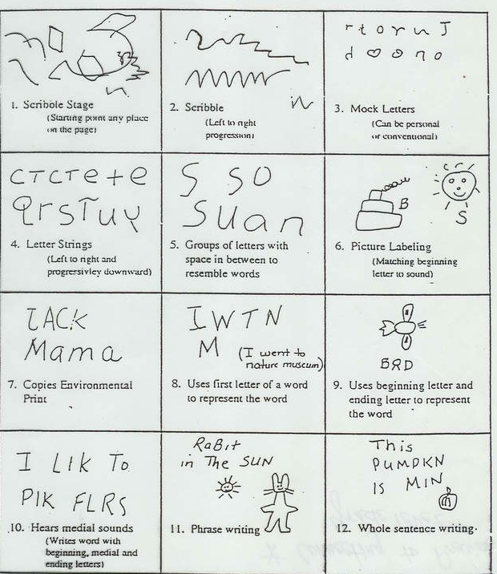

Slide 15
Specials
Every day the children get the opportunity to go to a “Specials” class. The Special area classes that the children will attend are: Art, Music, Physical Education, Technology, Media, and Guidance.

Slide 16
Shared Reading
Shared Reading is an interactive reading experience that occurs when students join in or share the reading of a big book while guided and supported by a teacher or other experienced reader. Students observe an expert reading the text with fluency and expression. The text must be large enough for all the students to see clearly, so they can share in the reading of the text. It is through Shared Reading that the reading process and reading strategies that readers use are demonstrated.

Slide 17
Literacy Centers
Literacy centers are stations where literacy activities are set up for independent or guided use. Examples of literacy centers include: reading the room, matching upper and lowercase letters or word families, doing “picture walks” through theme related books, reading to a buddy, and listening to reading on the computer or in the listening center. This allows the teacher to pull students to read in their small reading groups. These groups are differentiated to meet the specific needs and reading level of your child.

Slide 18
Lunchtime
At lunchtime, the children are taken to the dining hall and are seated at table K. Students that pack their lunch immediately go to their assigned table. Students that buy are given a card with their name and student ID number to enter at the register. Our lunchtime is from 12:10-12:40 everyday. You are welcome to join your child for lunch! Please make sure you sign in at the front office before meeting us in the cafeteria.
We encourage the children to eat their main course first before they start eating their snacks (and the real things they want to eat)!

Slide 19
Math
Math time is spent working on several skill areas including: counting and cardinality, shapes (2D/3D), addition and subtraction, and measurement. A normal math session usually includes a math related story, manipulative work on the white board, and counting exercises. In all parts of the mathematics program children learn by doing. The classroom is set up so that children can actively explore, investigate, estimate, make predictions, count, build, and talk about their ideas. Children are encouraged to tell how they arrive at their answers and to look for alternative ways to solve problems.

Slide 20
Handwriting
Learning to write can be stressful for students who may need practice with their fine motor skills. Children learn to print using hands-on materials and developmentally appropriate activities such as individual whiteboards, tracing in sand or even shaving cream! This fine motor practice prepares students for pencil and paper success .

Slide 21
Outdoor PE
Outdoor play refines a child's gross-motor and very important social skills. Playground time is also an opportunity to explore and manipulate a different environment. Children love outdoor play because they can let loose their imaginations while getting physical. We have outdoor PE everyday from 2:10-2:40.

Slide 22
Snack & Read Aloud
Snack time is an opportunity for the children to learn social skills as they chat with friends at their table. During this time we also share a read aloud of the children’s choice. Please send your child to school everyday with one small, healthy snack. Snack time is only about 10 minutes.

Slide 23
Word Work
Phonics is the awareness of letter and sound relationships. It is the link between what we say and what we can read and write. Phonics is taught in a variety of ways including: letter recognition, connecting the letters with their sounds, teaching and reinforcing sight words, and reading and writing easy consonant-vowel-consonant words. We will introduce new “Word Wall Words” gradually so that by the end of Kindergarten students will have a core of sight words that they can read and write.
Letterland is our phonics program that we are using this year.

Slide 24
Social Studies
During Social Studies, the children will discuss and gain a better understanding of citizenship, how we are alike and different, cultures around the world, needs and wants, and geography. Throughout the year we will talk about various holidays and cultures.
4 Social Studies Topics
* I am a Citizen (Rules)
* We are alike and different
* Needs and Wants
* Maps

Slide 25
Science
During science, students will make observations and build an understanding of similarities and differences in animals, weather concepts, and the properties of common objects. They will also use appropriate tools and measurements to increase their ability to describe their world. FOSS kits are used for our science classes which allow for the children to have authentic, hands-on learning experiences.
3 Science Units
* Investigating Properties
* Weather
*Animals 2X2

Slide 26
Dismissal
At Alston Ridge, we have a silent dismissal that is done entirely on the television. During this time, students traveling home via carpool and daycare vans are given color coded tags. The students watch each mode of transportation be announced on the television through the use of appropriate symbols (car, numbered buses, after school care). If a student were to forget his or her bus number, he or she may refer to the “How We Go Home” list. If a child’s mode of dismissal changes, the parent or guardian must call or send a note in to school.

Slide 27
Thank you for coming! I look forward to working with you all!

